Slide 1



The Dual
What a minute, is it dual or duel? ... Dual is an adjective that means having two parts. Duel is a verb or a noun, and refers to a conflict between two entities.
Even though this is a military school, we are interested in the former, not the latter.
Code Duello: The Rules of Dueling
The Code Duello, covering the practice of dueling and points of honor, was drawn up and settled at Clonmel Summer Assizes in 1777
https://www.pbs.org/wgbh/americanexperience/features/duel-code-duello-rules-dueling/

Slide 2
The Dual
Consider the production of 5 products on 3 machines
 |  | Products | (time in | hours) |  | Available
 | 1 | 2 | 3 | 4 | 5 | Capacity (hours)
Machine 1 | 3 | 2 | 5 | 8 | 7 | 60
Machine 2 | 6 | 1 | 0 | 1 | 10 | 60
Machine 3 | 3 | 5 | 2 | 8 | 1 | 45
Profit | 30 | 20 | 21 | 32 | 25

Slide 3
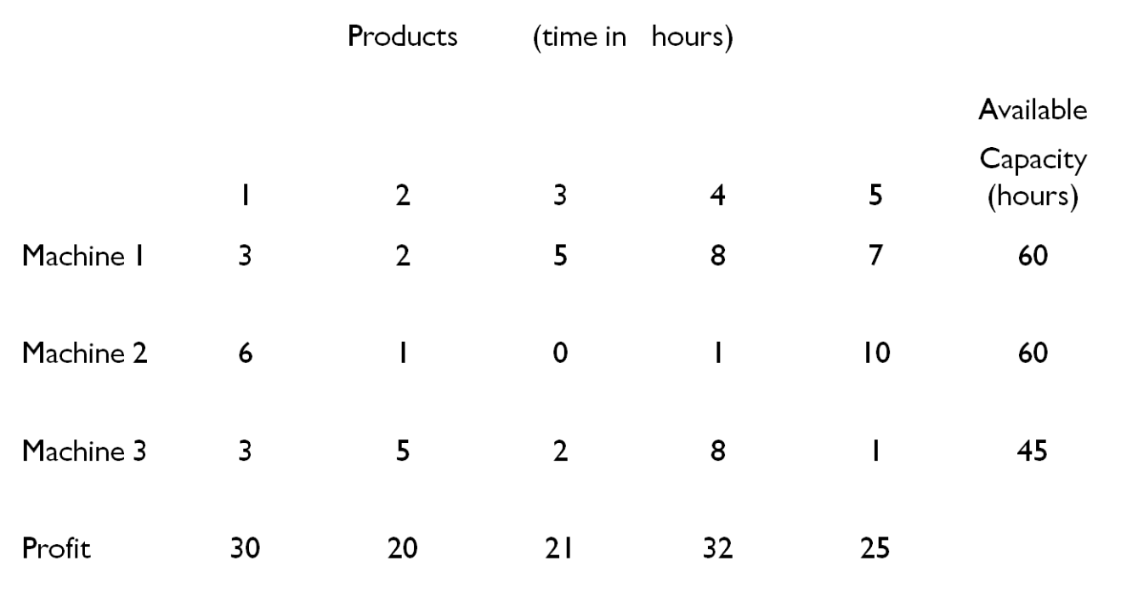
The Dual
Let x_{j} = units of product j to produce
Max z = 30x₁ + 20x₂ + 21x₃ + 32x₄ + 25x₅
s.t. 3x₁ + 2x₂ + 5x₃ + 8x₄ + 7x₅ ≤ 60
6x₁ + 1x₂ + 0x₃ + 1x₄ + 10x₅ ≤ 60
3x₁ + 5x₂ + 2x₃ + 8x₄ + 1x₅ ≤ 45
x₁ , x₂ , x₃ , x₄ ,x₅ ≥ 0

Slide 4
The Dual
Let x_{j} = units of product j to produce
Max z = 30x₁ + 20x₂ + 21x₃ + 32x₄ + 25x₅
s.t. 3x₁ + 2x₂ + 5x₃ + 8x₄ + 7x₅ ≤ 60
6x₁ + 1x₂ + 0x₃ + 1x₄ + 10x₅ ≤ 60
3x₁ + 5x₂ + 2x₃ + 8x₄ + 1x₅ ≤ 45
x₁ , x₂ , x₃ , x₄ ,x₅ ≥ 0
Final Tableau (Truncated to two decimal places)
Solution Shadow prices
x₁ = 9.87 Constraint 1 is 3.31
x₂ = 0.77 z = 432.69 Constraint 2 is 2.23
x₃ = 5.77 Constraint 3 is 2.23
x₄ = 0
x₅ = 0

Slide 5
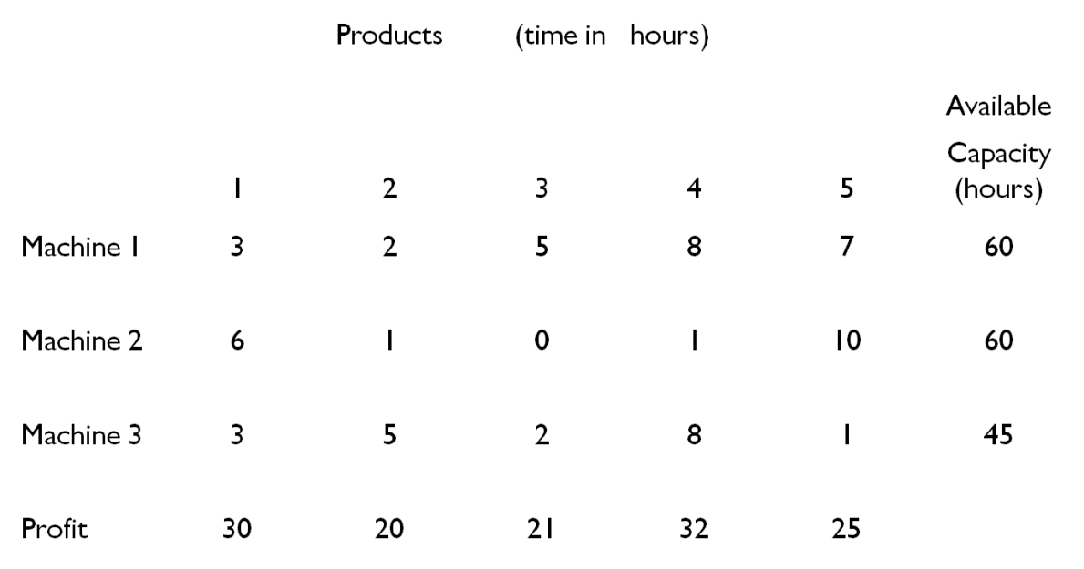
The Dual
Let y_{i} = rent paid for each hour on machine i
Min v = 60y₁ + 60y₂ + 45y₃
s.t. 3y₁ + 6y₂ + 3y₃ ≥ 30
2y₁ + 1y₂ + 5y₃ ≥ 20
5y₁ + 0y₂ + 2y₃ ≥ 21
8y₁ + 1y₂ + 8y₃ ≥ 32
7y₁ + 10y₂ + 1y₃ ≥ 25
y₁ , y₂ , y₃ ≥ 0

Slide 6
The Dual
Let y_{i} = rent paid for each hour on machine i
Min v = 60y₁ + 60y₂ + 45y₃
s.t. 3y₁ + 6y₂ + 3y₃ ≥ 30
2y₁ + 1y₂ + 5y₃ ≥ 20
5y₁ + 0y₂ + 2y₃ ≥ 21
8y₁ + 1y₂ + 8y₃ ≥ 32
7y₁ + 10y₂ + 1y₃ ≥ 25
y₁ , y₂ , y₃ ≥ 0
Final Tableau (Truncated to two decimal places)
Solution Shadow prices
y₁ = 3.31 Constraint 1 is 9.87
y₂ = 2.23 v = 432.69 Constraint 2 is 0.77
y₃ = 2.23 Constraint 3 is 5.77
Constraint 4 is 0
Constraint 5 is 0
Because it is a minimization we take the negative of the value in the z row for the surplus variables

Slide 7
The Dual
Answer to the producers problem:
x₁ = 9.87 , x₂ = 0.77, x₃ = 5.77, x₄ = 0, x₅ = 0
shadow prices:
const 1 = 3.31, const 2 = 2.23, const 3 = 2.23
z = 432.69
Answer to renter’s problem:
y₁ = 3.31, y₂ = 2.23, y₃ = 2.23
shadow prices:
const 1 = 9.87 , const 2 = 0.77, const 3 = 5.77, const 4 =0, const 5 = 0
v = 432.69

Slide 8
The Dual
These two problems are primal-dual to each other. Associated with every linear programming problem is another problem – the dual. If we have solved one, we have solved the other.
Characteristics – The primal is which ever problem you start with; we will assume, for discussion purposes, that we started with a maximization problem.
Primal (maximization) Dual (minimization)
Objective function coefficients Right hand sides
Right hand side Objective function coefficients
j^{t h} column of coefficients j^{t h} row of coefficients
i^{t h} row of coefficients i^{t h} column of coefficients
j^{t h} variable is non-negative j^{t h} constraint is ≥
j^{t h} variable is urs j^{t h} constraint is =
where urs means unrestricted in sign

Slide 9
The Dual
Finding the dual of a linear program is simplified by getting the problem into conventional form; a maximization problem with all ≤ constraints and non-negative variables or a minimization with all ≥ constraints and non-negative variables.
Primal:
Dual:

Slide 10
The Dual
If a maximization problem has a ≥ constraint in it, we can convert it to a ≤ constraint by multiplying it by -1 and reverse it.
If a minimization problem has a ≤ constraint in it, we can convert it to a ≥ constraint by multiplying it by -1 and reverse it.
If we have an equality constraint, we can replace it with two constraints, one ≥ and the other ≤ and reverse one as needed.
∑ a_{i j} x_{j} = b_{i}
is replaced with
∑ a_{i j} x_{j} ≤ b_{i}
and ∑ a_{i j} x_{j} ≥ b_{i}
The only place these two constraints can be satisfied is where the equality is satisfied.

Slide 11
The Dual
Suppose we have made the substitution for ∑ a_{i j} x_{j} = b_{i} in a maximization problem. We would have
∑ a_{i j} x_{j} ≤ b_{i}
and ∑ a_{i j} x_{j} ≥ b_{i}
or ∑ a_{i j} x_{j} ≤ b_{i}
and -∑ a_{i j} x_{j} ≤ -b_{i}
The two dual variables generated by these constraints, say y_{i} and y_{i}’ would be the negatives of each other.
We would have y_{i} - y_{i}’ in each column. This is exactly the substitution for a variable unrestricted in sign.

Slide 12
Weak Duality
The objective function of any feasible solution of the primal maximization problem is bounded from above by the value of the objective function for any feasible solution of the dual.
Similarly, the value of the objective function for its dual is bounded from below by the value of the value of the objective function of the primal for any feasible solution.
Dual Feasible
v decreasing
Primal Feasible
z increasing

Slide 13
Weak Duality
Weak Duality Property
If j = 1, 2, 3, …, n is a feasible solution to the primal problem and i = 1, 2, 3, …, m is a feasible solution to the dual problem, then

Slide 14
Weak Duality

Slide 15
Weak Duality

Slide 16
The Dual
Optimality Property
If χ_{j}, j = 1, 2...n is a feasible solution to the primal problem and ỳ_{i} 1, i = 1, 2,…m is a feasible solution to the dual problem and
∑c_{j} χ_{j} = ∑ b_{i} ỳ_{i}
then χ_{j}, j = 1, 2...n is an optimal solution to the primal problem and ỳ_{i} 1, i = 1, 2,…m is an optimal solution to the dual problem.
Unboundness Property
If the primal (dual) problem has an unbounded solution, then the dual (primal) problem is infeasible.
This follow directly from the Weak Duality Property. For any feasible solution to the primal (assuming maximization), the dual must provide an upper bound on the primal objective function, which would contradict the unboundedness.

Slide 17
The Dual
Strong Duality Property
If the primal (dual) problem has a finite optimal solution, then so does the dual (primal) problem and these two values are equal. That is, where
Adding slacks to the primal maximization problem yields

Slide 18
The Dual
Strong Duality Property
For some optimal solution , j = 1, 2,,…n let the associated shadow prices be i = 1, 2, …m.
Recall that . This also holds for the objective function .
To maintain an optimal solution,
For a decision variable
C _{BV} B⁻¹a_{i,j}-c_{j} ≥ 0 (text tableau) or c_{j} – z_{j} ≤ 0 (classic tableau) j = 1, 2, …,n
For a slack variable
C _{BV} B⁻¹a_{i,j}-c_{j} ≥ 0 (text tableau) or c_{j} – z_{j} ≤ 0 (classic tableau) j = n+1, n+2, …,n+m
But for a slack variable c_{j} is 0 and C _{BV} B⁻¹a_{i,j}-c_{j} = for j = n+i

Slide 19
The Dual
Strong Duality Property
Decision variables
Slacks
We know for an optimal solution and . Therefore,

Slide 20
The Dual
Strong Duality Property
From Weak Duality, we know
Since they are equal must be the minimum feasible solution to the primal.
Conditions:
Primal feasible Dual feasible
Primal feasible and unbounded Dual infeasible
Primal infeasible Dual feasible and unbounded
or
Dual is infeasible

Slide 21
The Dual
Complementary Slackness
If in an optimal solution of a linear program, the value of the dual variable (shadow price) associated with a constraint is non-zero, then that constraint must be satisfied with equality (slack is zero). Further if a constraint is satisfied with strict inequality (there is positive slack), then its corresponding dual variable is zero.
For a maximization problem
It follows from weak duality that
And with strong duality it follows

Slide 22
The Dual
Complementary Slackness
And from strong duality it follows
Considering only part of the equation

Slide 23
The Dual
Complementary Slackness
Any feasible solution to the original primal maximization problem must have
Any optimal solution will have
In order for to sum to zero, each term must be zero
Since
and
There can not be balancing positive and negative terms. If the term is not zero, it will be negative.

Slide 24
The Dual
Complementary Slackness
Any feasible solution to the dual minimization problem must have
Using the other side of the expression , we have

Slide 25
The Dual
Complementary Slackness
Any feasible solution to the dual minimization problem must have
Following the same logic one or the other or both terms must be zero for the sum to be zero.
Optimality Condition
If j = 1, 2, 3, …, n and i = 1, 2, 3, …, m are optimal solutions to the primal and dual problems if and only if the complimentary slackness conditions hold for both the primal and the dual problems.

Slide 26
Dual Simplex Method

Slide 27
Dual Simplex Method Introduction
The simplex method moves from basic feasible solution to basic feasible solution until a set of optimality conditions are satisfied.
While maintaining feasibility,
We move toward optimality.
In the Dual Simplex method, we start with the optimality conditions satisfied, but with an infeasible basic solution.
We make our pivots in order to reduce the amount of infeasibility in the problem.
Optimality is maintained while infeasibility is reduced.
For a maximization primal problem
Our primal problem is primal feasible with the initial right hand sides non-negative.
Unless the initial tableau is also optimal, at least one coefficient in objective row is negative.
The dual of such a problem would not be feasible.
Recall the objective function coefficients in the primal become the RHS in the dual.
The problem would not be dual feasible.
As we pivot, the ratio test maintains feasibility in the primal, while pushing the objective toward optimality by entering the variable that will most increase the objective function (has the best objective row coefficient).
The process terminates when all the objective function row coefficients become non-negative – a feasible solution to the dual.

Slide 28
The Dual Simplex Method
Dual Simplex Method
Step 1: If the problem has a feasible solution which passes the optimality test, stop. Otherwise go to (2).
Step 2: Select as the key row, i*, the row with the largest infeasibility. (The row with the smallest current .) Go to (3).
Step 3: Select as the key column, j*, the column which satisfies the condition
If all > 0, the problem is infeasible.
Step 4: Pivot on in the usual manner. Go to (1).

Slide 29
The Dual Simplex Method - Example
Consider the following example:
Min z = 6x₁ + 3x₂ + 2x₃
s.t 1x₁ + 1x₂ + 1x₃ ≥ 20
½ x₁ + ½ x₂ + ¼ x₃ ≥ 6
2x₁ + 1x₂ + 1x₃ ≥ 10
x₁ , x₂ , x₃ ≥ 0
Convert constraints to ≤ and the objective to max by multiplying by -1
Max - z = -6x₁ - 3x₂ - 2x₃
s.t - 1x₁ - 1x₂ - 1x₃ ≤ - 20
-½ x₁ - ½ x₂ - ¼ x₃ ≤ -6
-2x₁ - 1x₂ - 1x₃ ≤ -10
x₁ , x₂ , x₃ ≥ 0

Slide 30
The Dual Simplex Method - Example
The tableau is indicating an optimal solution (all ≥ ) but it is not feasible – some of the RHS are < 0.
Note, however, that the dual would be feasible but not optimal
.
The min value comes from the ratio for x₃,
so j* = 3.

Slide 31
The Dual Simplex Method - Example
-z | x₁ | x₂ | x₃ | x₄ | x₅ | x₆ | RHS | BV
1 | 4 | 1 | 0 | 2 | 0 | 0 | -40 | -z
0 | 1 | 1 | 1 | -1 | 0 | 0 | 20 | x₃
0 | -¼ | -¼ | 0 | -¼ | 1 | 0 | -1 | x₅
0 | -1 | 0 | 0 | 1 | 0 | 1 | 10 | x₆
j* = 2

Slide 32
The Dual Simplex Method - Example
-z | x₁ | x₂ | x₃ | x₄ | x₅ | x₆ | RHS | BV
1 | 3 | 0 | 0 | 1 | 4 | 0 | -44 | -z
0 | 0 | 0 | 1 | -2 | 4 | 0 | 16 | x₃
0 | 1 | 1 | 0 | 1 | -4 | 0 | 4 | x₂
0 | -1 | 0 | 0 | 1 | 0 | 1 | 10 | x₆
Answer
x₁ = 0
x₂ = 4
x₃ = 16
-z = -44 or z = 44

Slide 33
Adding a Constraint
If we add a new constraint to an optimal tableau, one of three conditions can occur.
The current optimal solution is feasible for the new constraint and therefore remains optimal.
The current optimal solution is not feasible for the new constraint, but a new feasible solution can be found.
The addition of the new constraint has rendered the problem infeasible.
Assume a ≤ constraint
[ a_{N} ] = be the row vector for the new constraint
Where is the vector of a_{i,j} for the basic variables (in order)
is the vector of a_{i,j} for the nonbasic variables
1 is the coefficient for the slack variable in the new ≤ constraint
B₀ is the original B matrix for the problem before the addition of the new constraint
W is the vector of a_{i,j} (j = 1, 2, 3, … , n, n+1, n+2, … n+m) for the new constraint
B₀⁻¹ is the inverse of the B₀ matrix

Slide 34
Adding a Constraint

Slide 35
Adding a Constraint - Example

Slide 36
Adding a Constraint - Example

Slide 37
Adding a Constraint - Example

